Slide 1

Function Context
Understanding the "This" Keyword in JavaScript
SoftUni Team
Technical Trainers
Software University
https://softuni.bg

Slide 2
Table of Contents
What Is "this"?
Usages Of "this" Keyword
In Objects
In Browser
In Events
"this" In Functions
Explicit Binding
Internal Object Properties

Slide 3
Have a Question?
sli.do
#js-advanced

Slide 4
Introduction to "this"
this
What is "this" ?

Slide 5
What is Function Context?
The function context is the object that owns the currently executed code
Function context === this object
Depends on how the function is invoked
Global invoke: func()
object.function()
domElement.event()
Using call() / apply() / bind()

Slide 6
this
Special keyword in JavaScript
Its value is based on the context
There are differences in strict mode
The object that this refers to changes every time execution context is changed

Slide 7
"this" Refers to the Global Object
When used alone, the owner is the Object [global]
function solve() {
return this;
}
console.log(solve() === global) // true

Slide 8

"this" Keyword in the Browser
let b = "b";
console.log(this.b); //undefined
var a = "a";
console.log(this.a); //a
function foo() {
console.log("Simple function call");
console.log(this === window); // true
} foo();

Slide 9

Usages Of "this" Keyword
"this" in Different Context

Slide 10
"this" in a Method
Refers to the owner of the method
let person = {
firstName: "Peter",
lastName: "Ivanov",
fullName: function(){
return this.firstName + " " + this.lastName
},
whatIsThis: function(){ return this }
} console.log(person.fullName()); // Peter Ivanov
console.log(person.whatIsThis()); // person

Slide 11
"this" Refers to the Parent Object
function foo() {
console.log(this === global);
}
let user = {
count: 10,
foo: foo,
bar: function () { console.log(this === global); }
}
user.foo() // false
let func = user.bar;
func() // true
user.bar() // false

Slide 12
In Events
In event handlers, this is set to the element the event fired from
element.addEventListener("click", function(e) {
console.log(this === e.currentTarget); // Always true
});

Slide 13
"this" in Classes
The value of this refers to the newly created instance
class Person {
constructor(fn, ln) {
this.first_name = fn;
this.last_name = ln;
this.displayName = function () {
console.log(`Name: ${this.first_name} ${this.last_name}`);
} } };
let person = new Person("John", "Doe");
person.displayName(); // John Doe

Slide 14
"this" in Functions
f(x)

Slide 15
"this" with Inner Functions
this variable is accessible only by the function itself
function outer() {
console.log(this); // Object {name: "Peter"}
function inner() {
console.log(this); // Window
}
inner();
}
const obj = { name: 'Peter', func: outer }
obj.func();

Slide 16
"this" with Arrow Functions
this retains the value of the enclosing lexical context
function outer() {
const inner = () => console.log(this);
inner();
}
const obj = {
name: 'Peter',
func: outer
};
obj.func(); // Object {name: "Peter"}

Slide 17
Call, Apply, Bind
this
this
this
this
this
this
this
this
this
this
Explicit Function Binding

Slide 18
Explicit Binding
Occurs when call(), apply(), or bind() are used on a function
Forces a function call to use a particular object for this binding
function greet() {
console.log(this.name);
}
let person = { name:'Alex' };
greet.call(person, arg1, arg2, arg3, ...); // Alex

Slide 19
Changing the Context: Call
Calls a function with a given this value and arguments provided individually
const sharePersonalInfo = function (...activities) {
let info = `Hello, my name is ${this.name} and`+ + `I'm a ${this.profession}.\n`;
info += activities.reduce((acc, curr) => {
let el = `--- ${curr}\n`;
return acc + el;
}, "My hobbies are:\n").trim(); return info;
} // Continues on the next slide…

Slide 20
Changing the Context: Call
const firstPerson = { name: "Peter", profession: "Fisherman" };
console.log(sharePersonalInfo.call(firstPerson, 'biking', 'swimming','football'));
// Hello, my name is Peter.
// I'm a Fisherman.
// My hobbies are:
// --- biking
// --- swimming
// --- football

Slide 21
Changing the Context: Apply
Calls a function with a given this value, and arguments provided as an array
apply() accepts a single array of arguments, while call() accepts an argument list
If the first argument is undefined or null a similar outcome can be achieved using the array spread syntax

Slide 22
Apply() – Example
const firstPerson = {
name: "Peter",
prof: "Fisherman",
shareInfo: function () {
console.log(`${this.name} works as a ${this.prof}`);
}
};
const secondPerson = { name: "George", prof: "Manager" };
firstPerson.shareInfo.apply(secondPerson);
// George works as a Manager

Slide 23
Changing the Context: Bind
The bind() method creates a new function
Has its this keyword set to the provided value, with a given sequence of arguments preceding any provided when the new function is called
Calling the bound function generally results in the execution of its wrapped function

Slide 24
Bind – Example
const x = 42;
const getX = function () {
return this.x;
}
const module = {x , getX };
const unboundGetX = module.getX;
console.log(unboundGetX()); // undefined
const boundGetX = unboundGetX.bind(module);
console.log(boundGetX()); // 42

Slide 25
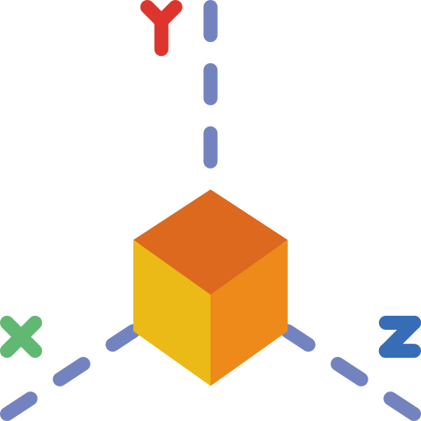
Problem: Area and Volume Calculator
The functions area and vol are passed as parameters to your function
function area() {
return this.x * this.y;
};
function vol() {
return this.x * this.y * this.z;
};

Slide 26
Problem: Area and Volume Calculator
Calculate the area and the volume of figures, which are defined by their coordinates (x, y and z), using the provided functions
'[
{"x":"1","y":"2","z":"10"},
{"x":"7","y":"7","z":"10"},
{"x":"5","y":"2","z":"10"}
]'
[
{ area: 2, volume: 20 },
{ area: 49, volume: 490 },
{ area: 10, volume: 100 }
]

Slide 27
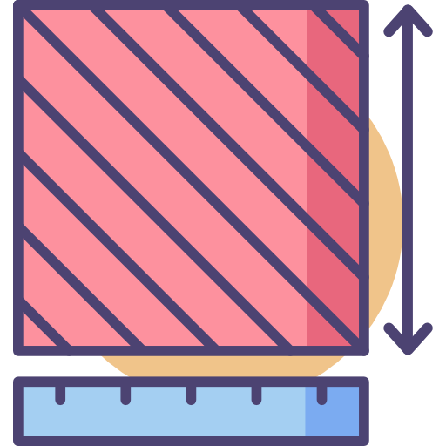
Solution: Area and Volume Calculator
function solve(area, vol, input) {
let objects = JSON.parse(input);
function calc(obj) {
let areaObj = Math.abs(area.call(obj));
let volumeObj = Math.abs(vol.call(obj));
return { area: areaObj, volume: volumeObj }
}
return objects.map(calc);
}

Slide 28

Internal Object Properties

Slide 29
Internal Properties
Every object field has four properties:
Enumerable - can access to all of them using a for…in loop
Enumerable property are returned using Object.keys method
Configurable - can modify the behavior of the property
You can delete only configurable properties
Writable - can modify their values and update a property just assigning a new value to it
Value

Slide 30
Object's Non-enumerable Properties
They won't be in for…in iterations
They won't appear using Object.keys function
They are not serialized when using JSON.stringify
let ob = {a:1, b:2};
ob.c = 3;
Object.defineProperty(ob, 'd', { value: 4, enumerable: false });
ob.d; // => 4
for( let key in ob ) console.log( ob[key] ); //1 2 3
Object.keys( ob ); // => ["a", "b", "c"]
ob; // => {a: 1, b: 2, c: 3, d: 4}
ob.d; // => 4

Slide 31
Object's Non-writable Properties
Once its value is defined, it is not possible to change it using assignments
If the non-writable property contains an object, the reference to the object is what is not writable, but the object itself can be modified
let ob = { a: 1 };
Object.defineProperty(ob, 'B', { value: 2, writable: false });
ob.B; // => 2
ob.B = 10;
ob.B; // => 2

Slide 32
Object's Non-configurable Properties
Once you have defined the property as non-configurable, there is only one behavior you can change
If the property is writable, you can convert it to non-writable
Any other try of definition update will fail throwing a TypeError
let ob = {};
Object.defineProperty(ob, 'a', { configurable: false, writable: true });
Object.defineProperty(ob, 'a', { enumerable: true }); // throws a TypeError
Object.defineProperty(ob, 'a', { value: 12 }); // throws a TypeError
Object.defineProperty(ob, 'a', { writable: false }); // This is allowed!!
Object.defineProperty(ob, 'a', { writable: true }); // throws a TypeError
delete ob.a; // => false

Slide 33
Object Freeze and Seal
let cat = { name: 'Tom', age: 5 };
Object.freeze(cat);
cat.age = 10; // Error in strict mode
cat.gender = 'male'; // Error in strict mode
console.log(cat); // { name: 'Tom', age: 5 }
cat = { name: 'Tom', age: 5 };
Object.seal(cat);
cat.age = 10; // OK
delete cat.age; // Error in strict mode
console.log(cat); // { name: 'Tom', age: 10 }

Slide 34
Problem: Person
Return an object with firstName, lastName and fullName
If firstName or lastName are changed, then fullName should also be changed
If fullName is changed, then firstName and lastName should also be changed
let person = new Person("Albert", "Simpson");
console.log(person.fullName);//Albert Simpson
person.firstName = "Simon";
console.log(person.fullName);//Simon Simpson

Slide 35

Solution: Person
function Person(first, last) {
this.firstName = first;
this.lastName = last;
Object.defineProperty(this, "fullName", {
set: function(value) {
// ToDo
},
get: function() {
// ToDo
}
}
);
}

Slide 36

Live Exercise in Class (Lab)
Practice

Slide 37

Summary
Functional Context
What this refers to depends on where and how the function that is being executed is called
bind, apply and call are all functions that can be used to explicitly set the value of this
Internal Object Properties
…
…
…

Slide 38
Questions?
Notes:
38

Slide 39
Trainings @ Software University (SoftUni)
Software University – High-Quality Education, Profession and Job for Software Developers
softuni.bg
Software University Foundation
softuni.foundation
Software University @ Facebook
facebook.com/SoftwareUniversity
Software University Forums
forum.softuni.bg
Notes:
39

Slide 40

License
This course (slides, examples, demos, exercises, homework, documents, videos and other assets) is copyrighted content
Unauthorized copy, reproduction or use is illegal
© SoftUni – https://about.softuni.bg/
© Software University – https://softuni.bg
Notes:
40

